Slide 1
„Girl and the wolf”
Elina Vincent

Slide 2
Authoress
Elina Vincent's seventeen years old. When she started writing the novel "The Girl and the Wolf", was, like the heroine, fifteen years old. It's senior year student of the class in one of Paris' high schools. Enamored in the wild, after several trips to South Africa and Canada wants to spend her life ... and continue to write.

Slide 3
In central Canada, the land of wild and beautiful, in a harsh northern climate ... Allie is fifteen years old and an orphan. After the tragic death of her parents closed in their own world: among the vast space of Canada. Until the meeting with a small, frightened, hairy ball: the wolf, who lost his mother ... At that time, a love story begins. Who whom will teach how to be free? At the heart of the wild world of Allie's not alone, surrounded by people who love her. Among them there is Mathieu, a young handsome Frenchman who tries to get close to Allie and know and understand the world. World Allie is a world of wolves, frozen space, the mountains and the endless horizon, where nothing happens by chance, and everything has its place.

Slide 4
Scourse: www.empik.com

Slide 5
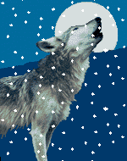
Details
Original title: Les Orphelins du Grand Nord
Publisher: Bela Med
Date of issue: 2005
Number of pages: 285
Keywords: adventure, prose
Category: Children's literature / young people
Scourse:
http://gify.magazynek.org/?dir=Zwierz%C4%99ta/Ssaki/Wilk

Slide 6
Book by Elina Vincent Fri "The Girl and the Wolf„ is a novel for young people, but also sensitive people. It tols about fifteen years old Allie, orphaned by parents who died in a tragic accident. In central Canada, the land of wild and beautiful, surrounded by loved ones, choose the association of a lost, scared, but really the intelligent and loyal wolf who has just lost his mother. Additionally, her life comes a young Frenchman, Matheiu, who tries to get close to the girl, and get to know her better, and understand the world. It's a great story, saying that life is not always beautiful, but sometimes cruel. It tols about the great friendship that does not appear only between people but also between man and animal. Reading it, I threw the tears in your eyes, because it created in me a great excitement and emotions. Certainly more than once I will read it again.

Slide 7
Patrycja Misztal III a
Patrycja Misztal III a

Slide 8
Quotes from the book
"This is a dream, Mathieu. And when reality intrudes into dreams, they are looking for some shelter. You're hiding it in his pocket and wear everywhere with you. However, do not forget about them„
"This is not the end, it's the start of something else. Killed the pain and come back to life„
"I have a strange feeling that you treat people as belonging to you toys. You're taking them when it suits you, you're doing with them what you like ... but not always the case may be ..„
"The Book of Life is the most important book that you can not open or close according to your own choice. One would like to return to the page on which you love, but the page on which the die is already under our fingers „
"This is a dream, Mathieu. And when reality intrudes into dreams, they are looking for some shelter. You're hiding it in his pocket and everywhere with you. However, do not forget about them"

Slide 9
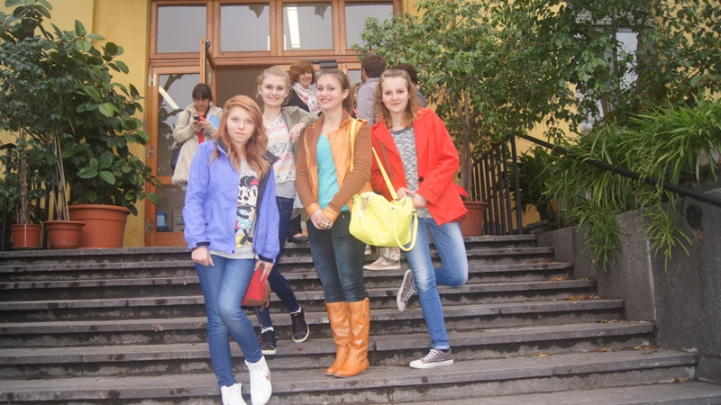
Prepared by:
Natalia Kunicka
Alicja Konieczna
Magdalena Ligorowska
Patrycja Misztal
Scourse: Katarzyna Stępień

