Slide 1
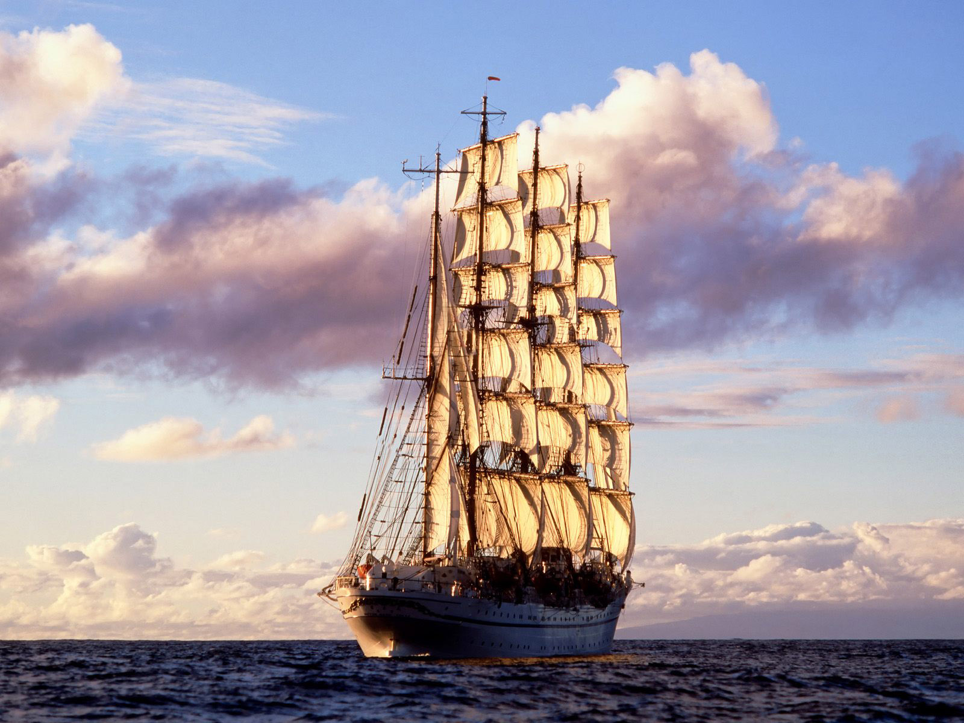
ODYSSEY by Homer

Slide 2
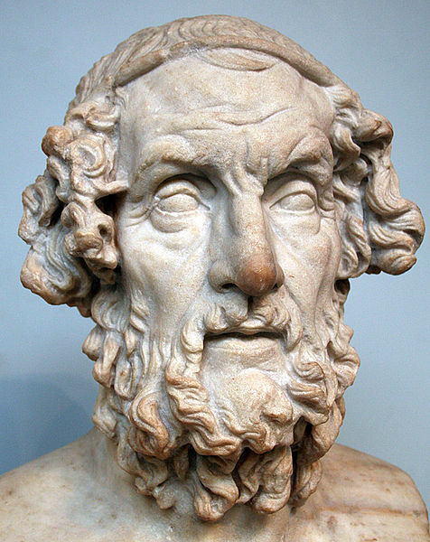
WHO WAS HOMER ?
Homer was a Greek traveling singer
It is believed that he is the father of ancient epic poetry
He is the author of the Iliad and the Odyssey
It is considered that Homer was blind
Homer was unique among the poets of his time
He used special style called Homeric, characterized by a large number of epithets
Idealized portrayal of Homer dating to the Hellenistic period. British Museum.
source: http://pl.wikipedia.org/wiki/Homer

Slide 3
source: www.wikipedia.pl
Homer and His Guide, by William-Adolphe Bouguereau (1825–1905), portraying Homer on Mount Ida, beset by dogs and guided by the goathered Glaucus

Slide 4
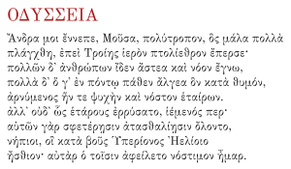
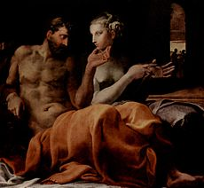
What is the Odyssey ?
The poem mainly centers on the Greek hero Odysseus (known as Ulysses in Roman myths) and his journey home after the fall of Troy. It takes Odysseus ten years to reach Ithaca after the ten-year Trojan War. In his absence, it is assumed he has died, and his wife Penelope and son Telemachus must deal with a group of unruly suitors, the Mnesteres or Proci, who compete for Penelope's hand in marriage.
Greek text of the Odyssey's opening passage
Odysseus and Penelope
by Francesco Primaticcio (1563)
Source: http://en.wikipedia.org/wiki/Odyssey and Katarzyna Droga - Gimbus

Slide 5
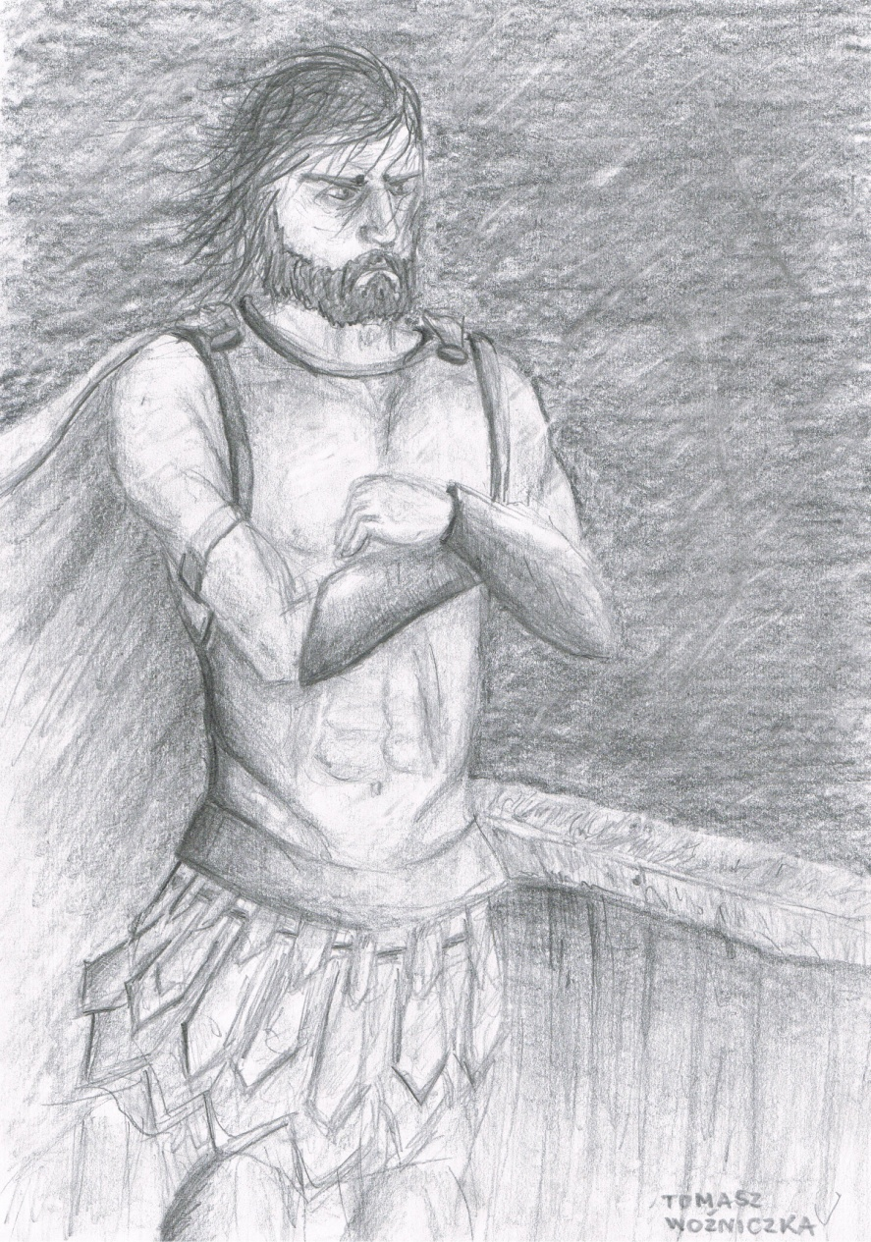
The Adventures of Odysseus
Trojan War
Poseidon’s curse
Visit at Eola and Lajstrygons
Kirke
Land of Kiremejczyks
From Kirke to Calypso
Help from Feak
The situation in Ithaca
Source: Tomasz Woźniczka

Slide 6
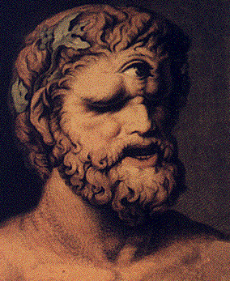
Cunning of Odysseus
On the way home from Troy, after a raid on Ismaros in the land of the Cicones, Odysseus and his twelve ships were driven off course by storms. They visited the lethargic Lotus-Eaters and were captured by the Cyclops Polyphemus, while visiting his island. Polyphemus was eating his men, and Odysseus took a barrel of wine and the Cyclops drank it, falling asleep. Odysseus and his men took a wooden stake, igniting it with the remaining wine, and burned his eye, blinding him. While they were escaping, however, Odysseus foolishly told Polyphemus his identity, and Polyphemus told his father, Poseidon, who had blinded him.
Polyphemus, by Johann Heinrich Wilhelm Tischbein, 1802
source: http://en.wikipedia.org/wiki/File:Polyphemus.gif and Katarzyna Droga - Gimbus

Slide 7
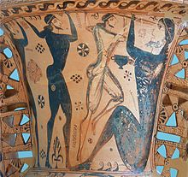
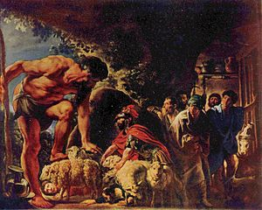
Odysseus and his men blinding the cyclops Polyphemus (detail of a protoattic amphora, c. 650 BC, museum of Eleusis)
Odysseus in the cave of Polyphemus by Jacob Jordaens, first half of 17th century.
Source: http://en.wikipedia.org/wiki/Polyphemus

Slide 8
Odysseus between Scylla and Charybdas
Being caught between the Scylla and Charybdas means to be caught in a situation that is extremely challenging. There is no good way to get through the situation, and any choice one makes will engender losses. The metaphor is comparable to the phrase being caught between a rock and a hard place.
Source: http://www.sienkiewicz.blox.pl

Slide 9
Quote of the Odyssey
„Music! Sing the husband, as the holy city of Troy
Demolished, the long and wandering, wandering its
The strength seen different cities, met so many people
Customs, and what adventures and hardships experienced!
And what vexation at sea when it came back
Or for his comrades stand in need,
To ensure their return! On the force he was doing,
But the comrades not saved: each of them struck
Himself, his own foolishness. Why devoted flock
Helios ate unruly crowd?
As punishment, God did not give back to enjoy.”
Source: http://odyseja.klp.pl/a-9936.html

Slide 10
Odyssey teaches us what?
Odysseus is a very important and really positive character. He taught us that we should not be put off by anything. We have to to fight for our goals and dreams. Do not worry if something goes wrong.
Polish proverb says:
"After the storm, the sun always comes.”
Source: http://www.sciaga.pl/tekst/104475-105-charakterystyka-odyseusza

Slide 11
Theme Penelope and Odysseus love
Odysseus and Penelope's relationship is a model example of a mature feeling that despite the distance, and uncertainty remains as strong and compelling. Couple History teaches us patience, and faith in the power of true love. The feast has become famous and to this day we remember about him (?).
Source: www.wikipedia.eu

Slide 12
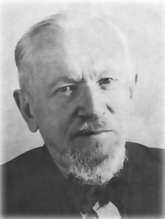
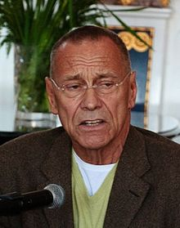
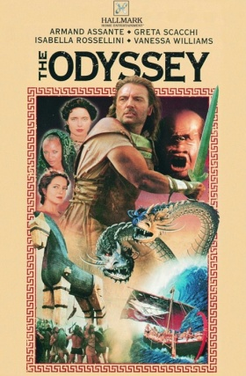
Inspiration for others
Odyssey was the inspiration for many artists, eg:
Polish poet Leopold Staff wrote a poem „ODYS” on on the basis of Odyssey
Russian film director, film producer and screenwriter Andriej Konczałowski directed the film „The Odyssey„
Source: oknotest.pl; http://pl.wikipedia.org/wiki/Andriej_Koncza%C5%82owski; http://pl.wikipedia.org/wiki/Leopold_Staff

Slide 13
Leopold Staff - Odysseus
Do not be concerned about
Thy sufferings and errors
Everywhere is a simple way
But everywhere and astray
That's it only
To continue to go forward boldly,
Because there is always a
Where else than he wanted
A stone with the inscription:
Here lies so-and-so
Each of us is Odysseus,
What goes back to his Ithaca
Scourse: www.wiersze.annet.pl/w,,11589

Slide 14
Thank you for attention
Presentations prepared by
Roksana Dłużniak

